Slide 1






CONTENTS
BUSINESS OVERVIEW
DATA ANALYTICS
ESG & INTEGRATED REPORTING
MARKETING
BUSINESS DEVELOPMENT
BUSINESS TRANSFORMATION
CORPORATE GOVERNANCE
BUSINESS
ADVISORY SERVICES
PROFILE
Integrity
We champion transparency, are independent, demonstrate honesty, ethical action & principles, fostering a trustworthy environment for our clients & team.
Curiosity
Our culture thrives on curiosity. We seek knowledge, challenge norms, ask the right questions & embrace innovation.
Excellence
Excellence is our commitment in all endeavors. We aim to surpass expectations, refining our craft & delivering outstanding results with every project. We put our clients first.
A DIVISION OF ARTIFICIAL INTELLIGENCE (Pty) Ltd BW00002314974

Slide 2



CONTENTS
BUSINESS OVERVIEW
DATA ANALYTICS
ESG & INTEGRATED REPORTING
MARKETING
BUSINESS DEVELOPMENT
BUSINESS TRANSFORMATION
CORPORATE GOVERNANCE
1
“
WELCOME TO
OUR DIVERSE
UNIVERSE
TABLE OF
CONTENTS
Business Overview
Data Analytics & Visualization
Integrated Reporting
Marketing Strategy
Business Development
Strategy Tracking & Reporting
Governance & Business Policy Development
"To see the world in a different way requires stepping out of familiar thought patterns and embracing new perspectives.
It involves challenging our own biases, actively seeking out diverse viewpoints, and being open to learning from experiences that are different.“
THAT’S OUR UNIVERSE.
Not the same
as something else.
It's a casual way of pointing out that something stands out, doesn't fit the usual pattern, or is unique in its own way.
Distinctive
characteristic or attribute that sets an entity, idea, or strategy apart from others in a competitive landscape.
Departure
from the common or known, often bearing significance in distinguishing lineage, heraldry, or philosophical thought.
Variance or deviation
from a standard, norm, or expected pattern.
THAT’S
WHAT WE WANT
OUR CLIENTS TO EXPERIENCE.
AI KONSULT
Contact Person : Scelo Hlope
Business Lead
Contact Number : (+267) 71-333-551
E-mail: scelo@ai.co.bw
Gaborone Botswana

Slide 3







CONTENTS
BUSINESS OVERVIEW
DATA ANALYTICS
ESG & INTEGRATED REPORTING
MARKETING
BUSINESS DEVELOPMENT
BUSINESS TRANSFORMATION
CORPORATE GOVERNANCE
1
About US
AI KONSULT
OUR PURPOSE
Our purpose is to help our clients create change and see the world in a different way. We believe that by leveraging our expertise and experience, we can help our clients build resilience and create high value.
The foundation of our work is solidly laid on meticulous research, data, and analytics.
OUR VISION
Democratizing Excellence.
OUR MISSION
We believe that everyone, regardless of background or circumstances, should have the opportunity to achieve their full potential.
In line with this mission,
Our purpose is to help our clients continuously set new standards of excellence in their respective industries.
WHO WE SERVE
We are committed to engaging with clients whom we can genuinely help.
Prior to establishing a long-term partnership, we prefer to conduct an extensive initial meeting.
This session is crucial for us to gain a comprehensive understanding of your business objectives and to assess how our services align with your needs.
If there is alignment, we dedicate our full-time to your project.
No distractions.
We only focus on your business.
WHO WE ARE
AI Konsult is an integrated business advisory services firm that provides businesses drive growth through emerging technology innovation.
We operate in Botswana, with a global view of the world
We provide an extensive range of services encompassing five key domains:
Customer Experience Management (CXM), Digital Transformation and Disruption, Data Analytics & Reporting, Performance Transformation, and Business Transformation.
No matter if you're a start-up or an established global brand, everyone needs a little extra help on their journey. Let Our Company be the ones that bring success to yours!
OUR SERVICES
Data Analytics, Visualization & Reporting
Business Transformation
Corporate Governance & ESG
Customer Experience Management (CXM)
Strategy
& Analysis

Slide 4


CONTENTS
BUSINESS OVERVIEW
DATA ANALYTICS
INTEGRATED REPORTING
MARKETING
BUSINESS DEVELOPMENT
BUSINESS TRANSFORMATION
CORPORATE GOVERNANCE
1
About US
AI KONSULT
Our Operating Model
Our Model
What We Do
Data,
Analytics, Visualization & Reporting
Our data and analytics unlock critical insights, driving data-driven decisions and strategic superiority in your industry and enhancing your reporting.
Performance Transformation
We optimize processes to elevate productivity and agility, pushing your business to achieve exceptional results.
Digital Transformation & Disruption
We specialize in c
Customer Experience Management (CXM)
We expertly craft unmatched customer journeys. Our strategies enhance satisfaction and loyalty, setting your business apart in a competitive marketplace.
Business Transformation
We offer comprehensive strategies to adapt and grow in an evolving business landscape, ensuring your organization stays ahead and thrives.
AI Konsult excels in empowering businesses with cutting-edge business development services. Our offerings are two-fold, focusing on creating impactful presentations and providing expert coaching.
Creating Smashing Presentations: We understand that in the business world, the first impression is often the last. Our team of skilled designers and content strategists work tirelessly to craft presentations that are not only visually stunning but also effectively communicate your business's core values, goals, and achievements.
Whether it's a pitch to potential investors, a product launch, or a company profile, our presentations are tailored to captivate your audience, leaving a lasting impression.
Visual Storytelling: We believe in the power of storytelling and incorporate this into every presentation, turning data and information into compelling narratives.
Design Excellence: Our design team uses the latest tools and trends to ensure your presentation stands out with a professional and modern aesthetic.
Customized Content: Each presentation is uniquely tailored to reflect your business’s identity, ensuring that your message resonates with your intended audience.
AI Konsult is an integrated business advisory services
We provide an extensive range of services encompassing five key domains:
Customer Experience Management (CXM), Digital Transformation and Disruption, Data Analytics & Reporting, Performance Transformation, and Business Transformation.
No matter if you're a start-up or an established global brand, everyone needs a little extra help on their journey. Let Our Company be the ones that bring success to yours!
Artificial
Intelligence (Pty) Ltd
Advisory Services
Technology
AI Konsult
HelloDoc
Pharmacy
Express
AI Konsult is an integrated business advisory services firm founded during the AI Konsult is an integrated business advisory services firm founded during the

Slide 5
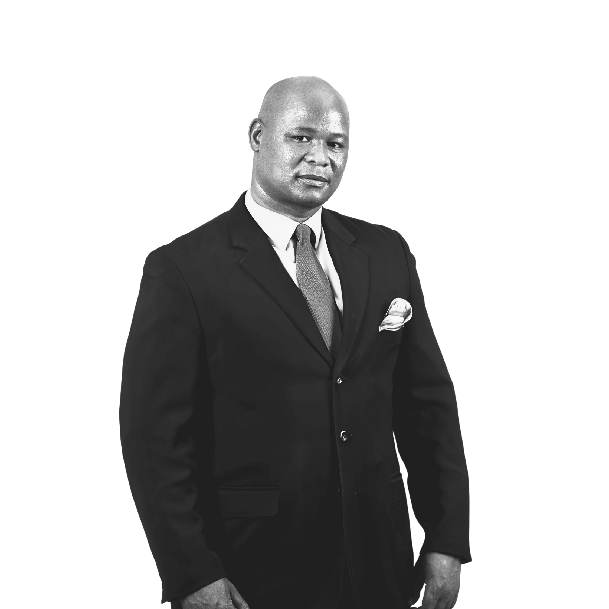




CONTENTS
BUSINESS OVERVIEW
DATA ANALYTICS
ESG & INTEGRATED REPORTING
MARKET
STRATEGY
BUSINESS DEVELOPMENT
BUSINESS TRANSFORMATION
CORPORATE GOVERNANCE
1
OUR ADVISORY PARTNERS
ADV. SIFISO NYONI
CORPORATE GOVERNANCE LEAD
Sifiso is a distinguished expert in governance, strategy, and insolvency law, known for his extensive knowledge and skills complemented by international experience.
Institute of Directors in South Africa (IoDSA),
Marketing Association of South Africa (MASA)
South African Restructuring & Insolvency Practitioners Association of South Africa (SARIPA)
INSOL International.
Sequestrations, Liquidations, Business Rescue
Restructuring & Turnarounds;
Labour Law;
Legal Compliance & Risk Management
Sustainable Development, ESG Matters & Integrated Reporting.
SCELO HLOPE
BUSINESS LEAD
Scelo's approach is characterized by a blend of strategic vision and practical execution. He believes in leveraging market insights to drive business growth and innovation, while maintaining strong financial discipline within business operations.
Business Transformation
Healthcare Application Development
Business Intelligence
Market Strategy
Data Analytics
Market Trend Analysis & Business Development
Product Development & CRM
Business & Integrated Reporting
KABELO BASUTLI
DATA TECHNOLOGY LEAD
Kabelo Basutli is a seasoned professional with over 20 years of experience in the IT sector, specializing in the intersection of technology and healthcare. He has established a reputation for excellence in ERP implementation, IT strategy development, and business process reengineering.
Informatics & Data Mining
Digital Transformation
Electronic Data Interchange (EDI)
IT Project Management
Cybersecurity in Healthcare
Healthcare Administration Systems
At AI Konsult, we are equipped with the expertise, a dedicated team, comprehensive knowledge, and extensive resources, all vital for guiding you through intricate business transformations.
Our innovative “See the world in a different way" strategy sets us apart, where we form multidisciplinary teams of global experts. These teams provide timely, data-driven insights and advice tailored to your specific needs.
TEBOGO MAPOSA
RESEARCH & STRATEGY LEAD
Tebogo Maposa, with two decades of experience, excels in business research, market analysis, and strategic planning for diverse industries.
Customer Feedback
Market Analysis: Competition Screening: Demand Generation:.
Market Forecasting: Sales Strategy:
Scenario Planning:
Strategic Planning: Market Modelling.
Investment Research
MONTWEDI BAKWENA
TRANSFORMATION LEAD
Montwedi excels in guiding organizations to industry leadership through cutting-edge technologies and agile methodologies. His areas of expertise include advanced technology implementation, agile project management, and strategic business alignment.
Digital transformation
Customer Experience (CX)
Change Management
Strategy

Slide 6

CONTENTS
BUSINESS OVERVIEW
DATA ANALYTICS
ESG & INTEGRATED REPORTING
MARKET
STRATEGY
BUSINESS DEVELOPMENT
BUSINESS TRANSFORMATION
CORPORATE GOVERNANCE
1
“
WELCOME TO
OUR DIVERSE
UNIVERSE
Strategies
Suggests a comprehensive and methodical approach.
Approaches
Indicates a specific way of addressing a problem or challenge.
Answers
Implies direct responses or resolutions to specific questions or issues.
Methods
Conveys a systematic way of handling situations.
Tools
Useful when referring to software, techniques, or equipment designed to handle specific tasks.
Services
Appropriate when the solution is service-based.
Systems
Ideal for solutions that involve a set of interacting or interdependent components.
Programs
Suggests a planned series of actions or procedures.
Techniques
Implies a skilled way of achieving a specific task.
Processes
Useful when the solution involves a series of actions or steps.
Innovations
Suggests a novel or creative approach.
Resolutions
Indicates the act of solving a problem or dispute.
Blueprints
Can be used metaphorically to suggest detailed plans or designs.
Frameworks
Useful for solutions that provide an underlying structure or support.
Protocols
Implies a set of rules or procedures to follow.
Models
Suggests a replicable and exemplary method or system.
Roadmaps
Indicates a detailed plan or strategy.
Packages
Useful when the solution is a combination of several elements or features.

Slide 7
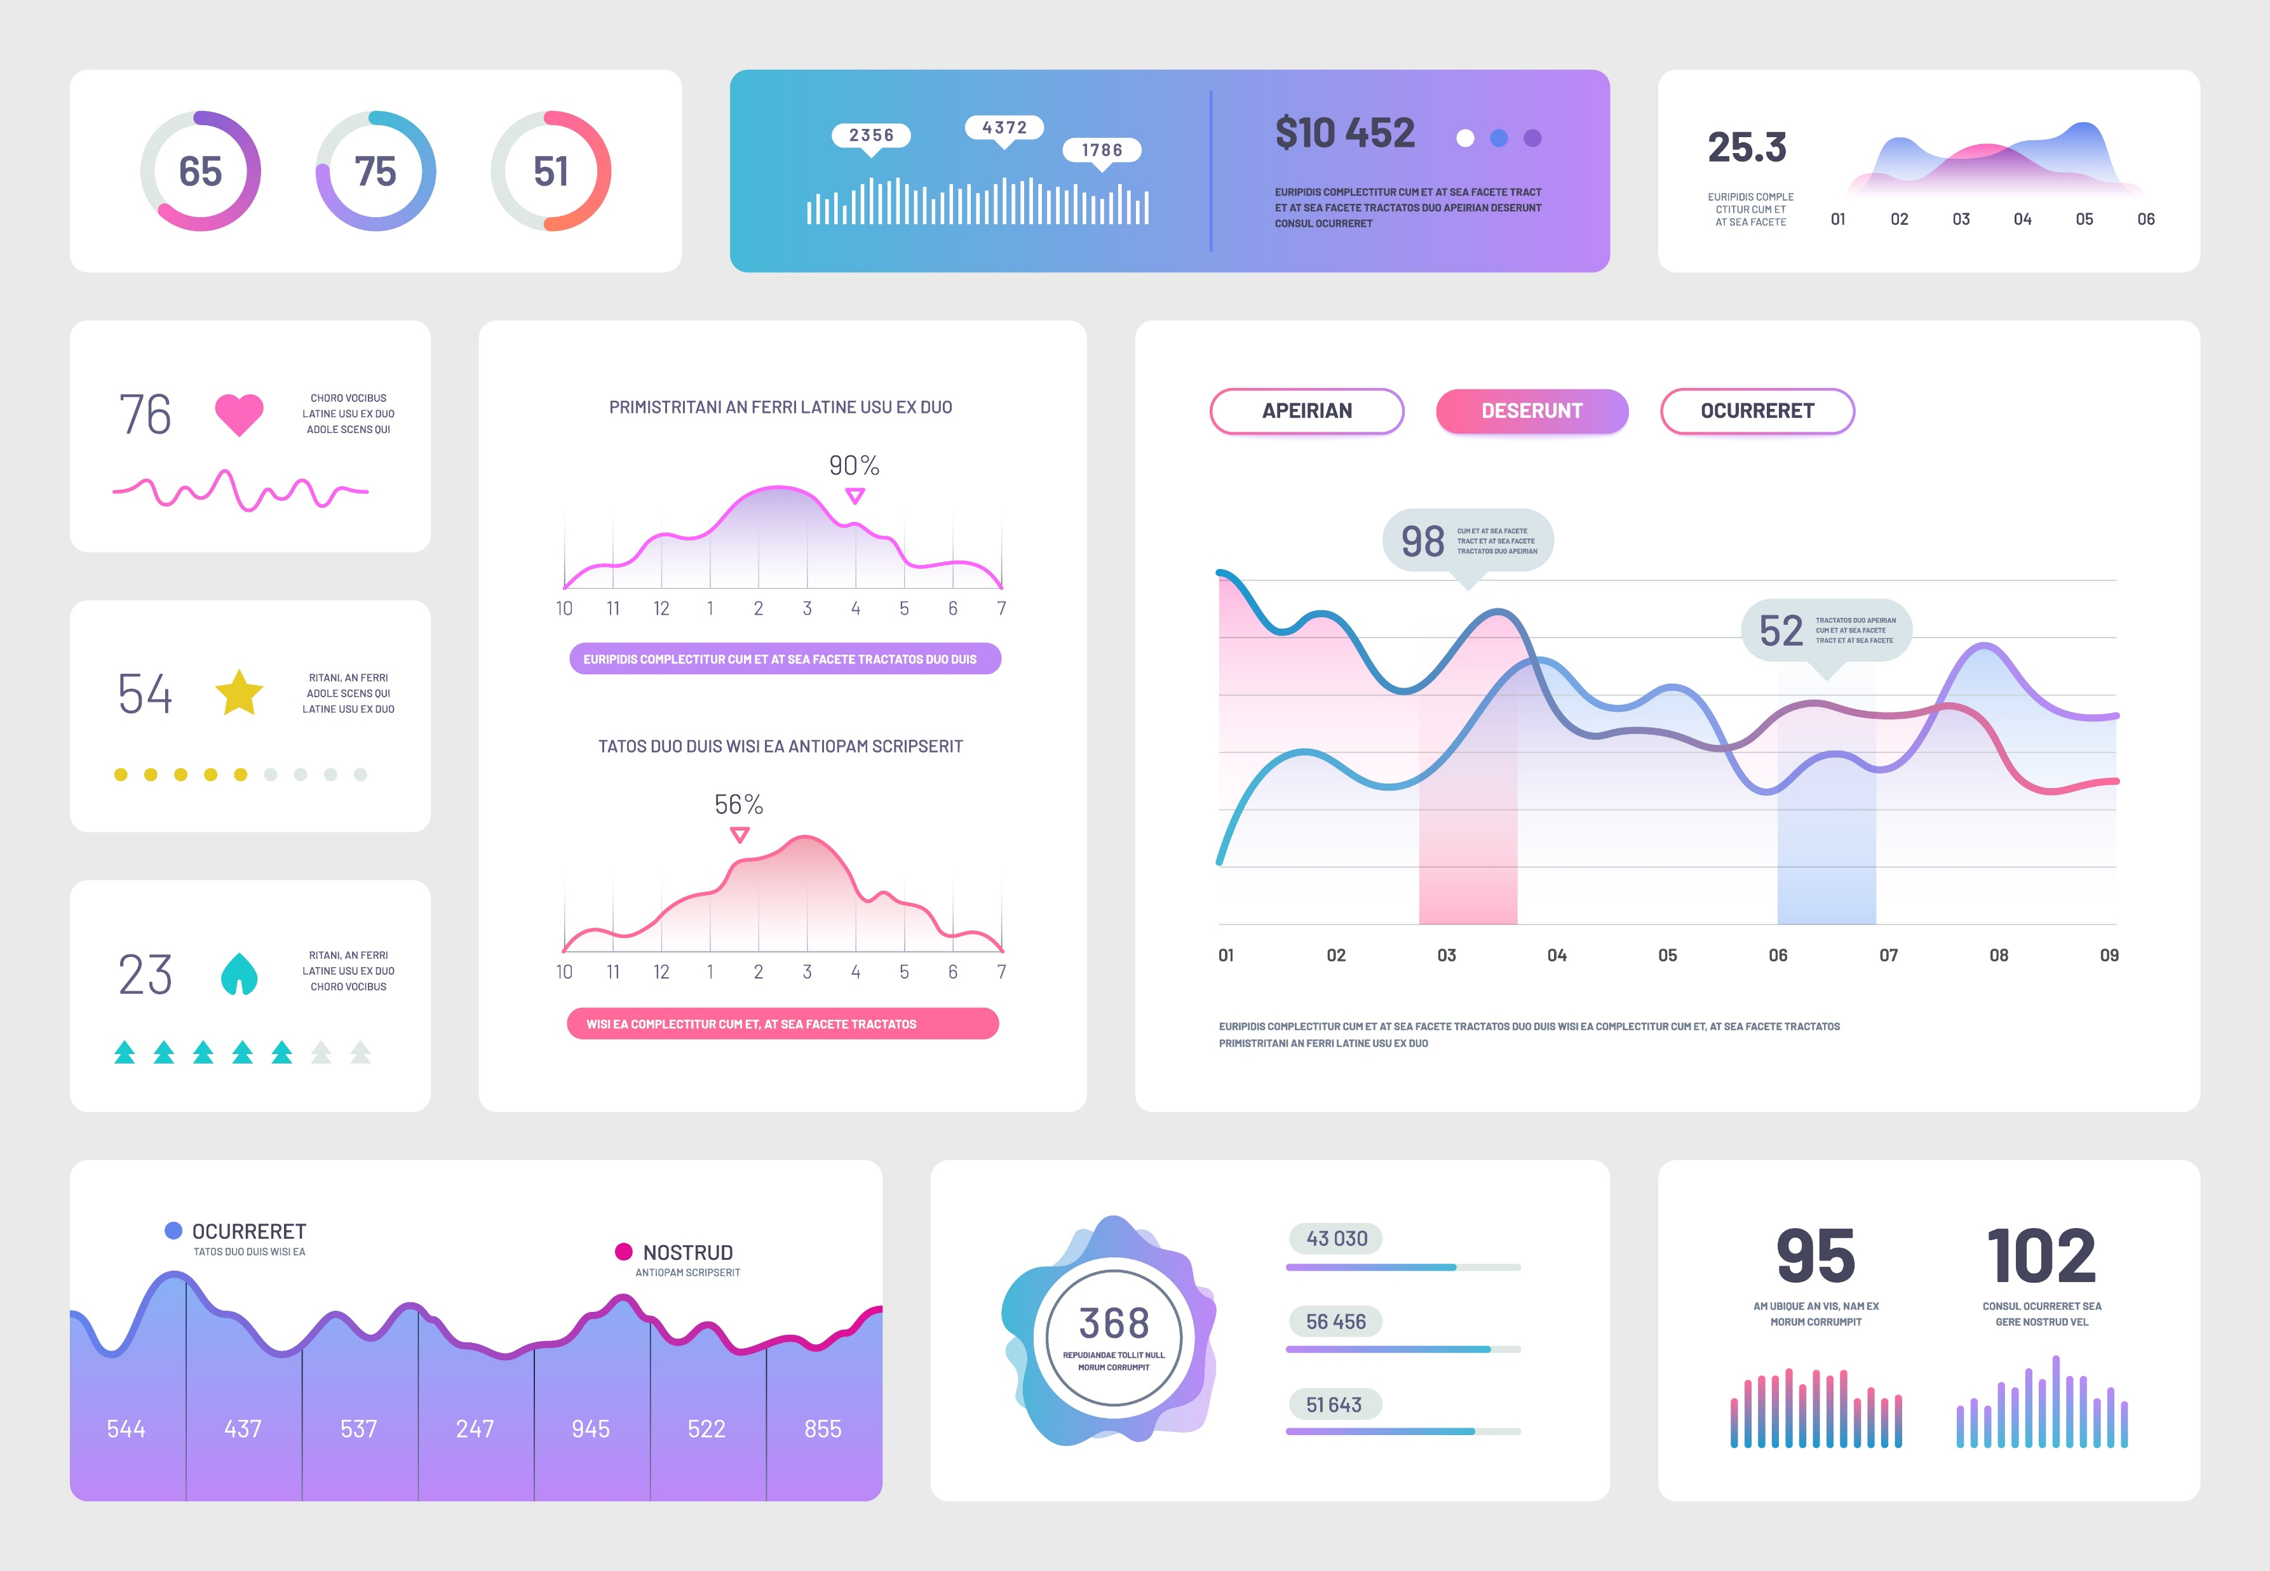
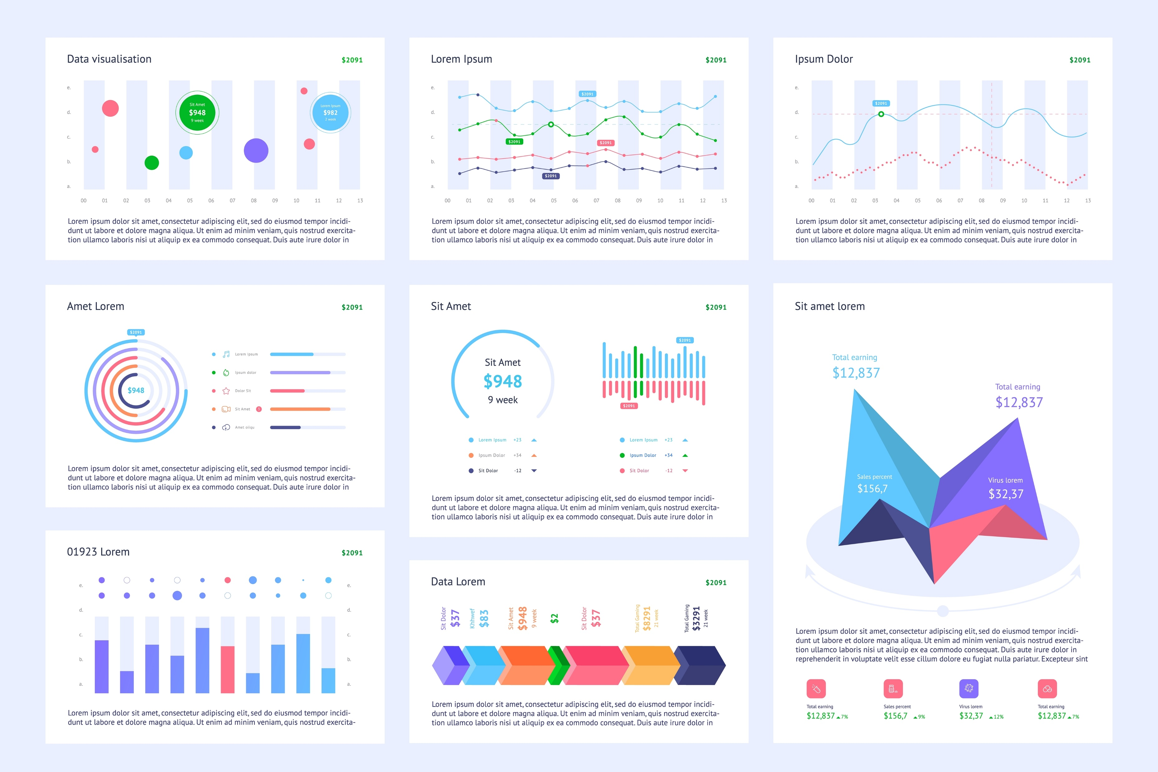
CONTENTS
BUSINESS OVERVIEW
DATA ANALYTICS
ESG & INTEGRATED REPORTING
MARKET
STRATEGY
BUSINESS DEVELOPMENT
BUSINESS TRANSFORMATION
CORPORATE GOVERNANCE
5
DATA ANALYTICS, VISUALIZATION & REPORTING SERVICES
Delivering Beautiful,
Easy-to-read Information
AI Konsult helps businesses integrate, aggregate, and analyze various data types from multiple data sources to address their most ambitious needs at department and enterprise levels.
Data Management & Integration
Services Included: Data Integration, Data Cleaning and Preprocessing, Big Data Analytics.
How we help you: We specialize in unifying data from various sources, ensuring it's cleaned, accurate, and actionable. We expertly handle large datasets, making them manageable and ready for analysis. This service benefits clients by providing a consolidated data foundation, crucial for accurate analytics and decision-making.
Advanced Analytics & AI Solutions
Services Included: Custom Analytics Solutions Development, Predictive Analytics, Prescriptive Analytics, Machine Learning and AI Integration, Data Mining and Pattern Recognition, Advanced Statistical Analysis.
How we help you: We develop tailored analytics models using advanced techniques, including AI and machine learning. We offer predictive insights and strategic recommendations based on data. Clients benefit from data-driven decision-making, enhanced forecasting abilities, and deeper insights into their operations and markets.
Visualization & Reporting
Services Included: Data Visualization, Dashboard and Report Designing, Real-Time Analytics.
How we help you: Creates intuitive visual representations of complex data sets and designs custom dashboards and reports for ongoing monitoring. This service is beneficial for clients who need to understand their data at a glance, offering accessible insights for stakeholders at all levels.
Business Intelligence & Self-Service Analytics
Services Included: Self-Service BI Tools Implementation, Descriptive Analytics, Customer Analytics, Supply Chain Analytics.
How we help you: We implements user-friendly BI tools, enabling non-technical users to conduct their own data analyses. We provide insights into customer behavior, supply chain efficiency, and overall business performance. Clients gain the advantage of self-reliance in data handling, leading to quicker, more informed decisions across the organization.
Compliance & Risk Management
Services Included: Risk Analytics, Regulatory Compliance and Data Governance.
How we help you: We focus on identifying and managing risks through data analysis and ensuring compliance with industry regulations. This service is crucial for clients to mitigate potential risks and adhere to legal standards, thereby protecting their reputation and operational integrity.
In the high-stakes environment of boardrooms and executive meetings, the clarity and precision of information can make the difference between a good decision and a great one.
AI Konsult specializes in data visualization consulting, focusing on making complex data easily understandable for business users through compelling visuals.
Our services include providing expert advice, implementing data visualization tools, and offering ongoing support. This approach allows businesses to convert extensive and intricate datasets into attractive and insightful visual representations. The goal is to address specific business queries and enable swift, data-driven decision-making with efficiency and clarity.
Making Data
Talk
We believe data should speak the language of leadership. Our specialty lies in distilling complex data into a narrative that is not just comprehensible but compelling to boards and management.
Data Visualization Excellence
Our visuals are crafted to be aesthetically pleasing and informative, ensuring that complex data is presented in an easy-to-digest format.
Customized Reporting Templates
Our visuals are crafted to be aesthetically pleasing and informative, ensuring that complex data is presented in an easy-to-digest format.
Actionable Recommendations
Our reports don't just inform; they advise. We provide clear, data-driven recommendations for your next steps.

Slide 8

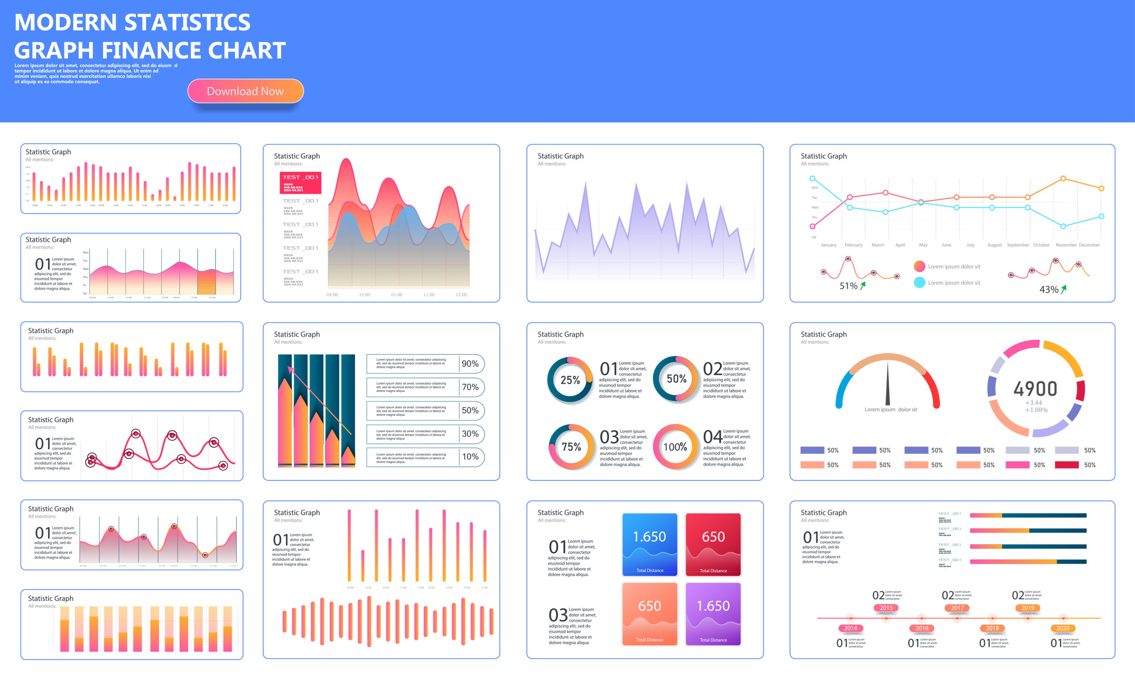
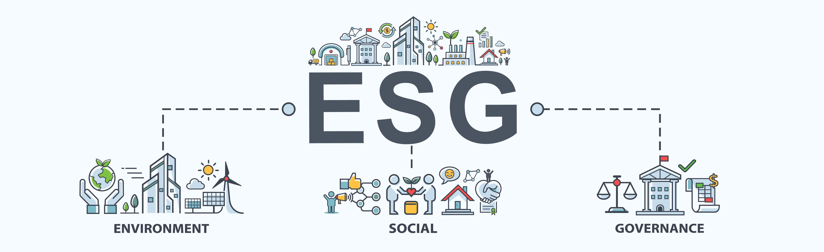
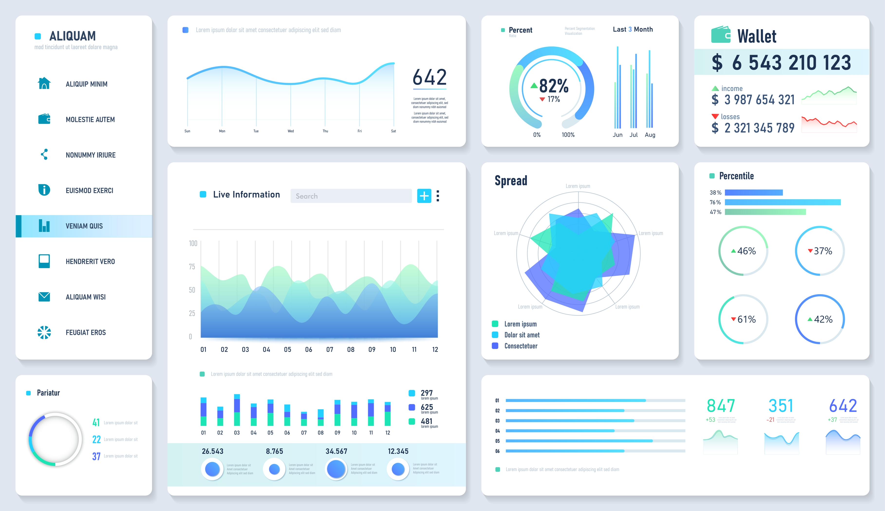
CONTENTS
BUSINESS OVERVIEW
DATA ANALYTICS
ESG & INTEGRATED REPORTING
MARKET
STRATEGY
BUSINESS DEVELOPMENT
BUSINESS TRANSFORMATION
CORPORATE GOVERNANCE
6
How We Can Elevate Your Reporting
Tailored Disclosure Strategies
We provide expert advice on the structure, outline, and content of your integrated report, ensuring clarity and impact.
Assurance Readiness Support
We evaluate and offer recommendations to enhance your reporting processes, data management, and controls, preparing you for assurance processes.
Materiality Assessment
Our approach includes a thorough materiality assessment to identify and prioritize stakeholder engagement on critical issues.
Enhanced Control Environments
We focus on analyzing and improving your control environments. This includes internal change management, data management processes, and streamlining opportunities for a robust integrated report.
IT Technology Integration
AI Konsult aids in selecting and implementing the right IT solutions to meet your evolving data collection and reporting requirements.
ESG & INTEGRATED REPORTING ADVISORY SERVICES
In today's fast-paced, data-driven business environment, clear and compelling reporting is more critical than ever.
At AI Konsult, we understand the complexities involved in crafting an integrated report. Our team, comprising experts in finance, sustainability, risk management, communications, and investor relations, collaborates to provide comprehensive guidance and support throughout your integrated reporting journey.
Choosing AI Konsult means you're not just receiving a report; you're acquiring a powerful tool that articulates your company's value creation story in a manner that resonates with stakeholders. Our interactive designs elevate your reports beyond mere readability, transforming them into engaging experiences that offer deep insights and foster stakeholder trust.
Our Approach
Objective Setting & Materiality Assessment: We begin by defining the objectives, scope, and target audience for our report. Then, we conduct a materiality assessment to identify the most critical issues that impact our business and stakeholders.
Data Collection & Stakeholder Engagement: We gather relevant financial and non-financial data from various departments. Simultaneously, we engage with stakeholders to understand their information needs and expectations.
Content Development & Strategy Integration: We develop the content of the report, integrating our organization's strategy, policies, and performance data. This involves crafting a narrative that aligns with our company's value creation and sustainability goals.
Design, Review, & Assurance: We design the report for maximum engagement and clarity. We conduct thorough internal reviews for accuracy and, if necessary, obtain external assurance for credibility, especially for data-driven and financial information.
Publication, Dissemination, & Feedback: After obtaining necessary approvals, we publish the report in the chosen formats and disseminate it to our stakeholders. Following this, we establish a feedback mechanism to gather stakeholder reactions and suggestions for continuous improvement.

Slide 9
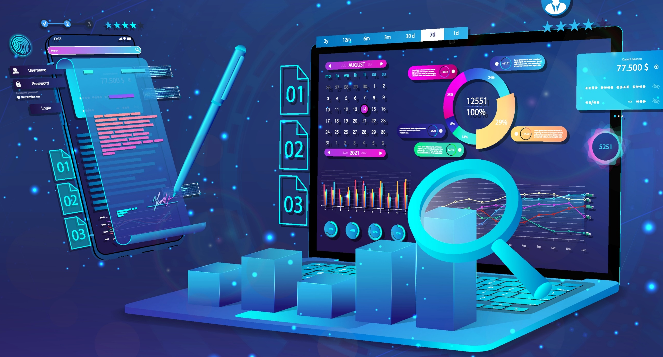
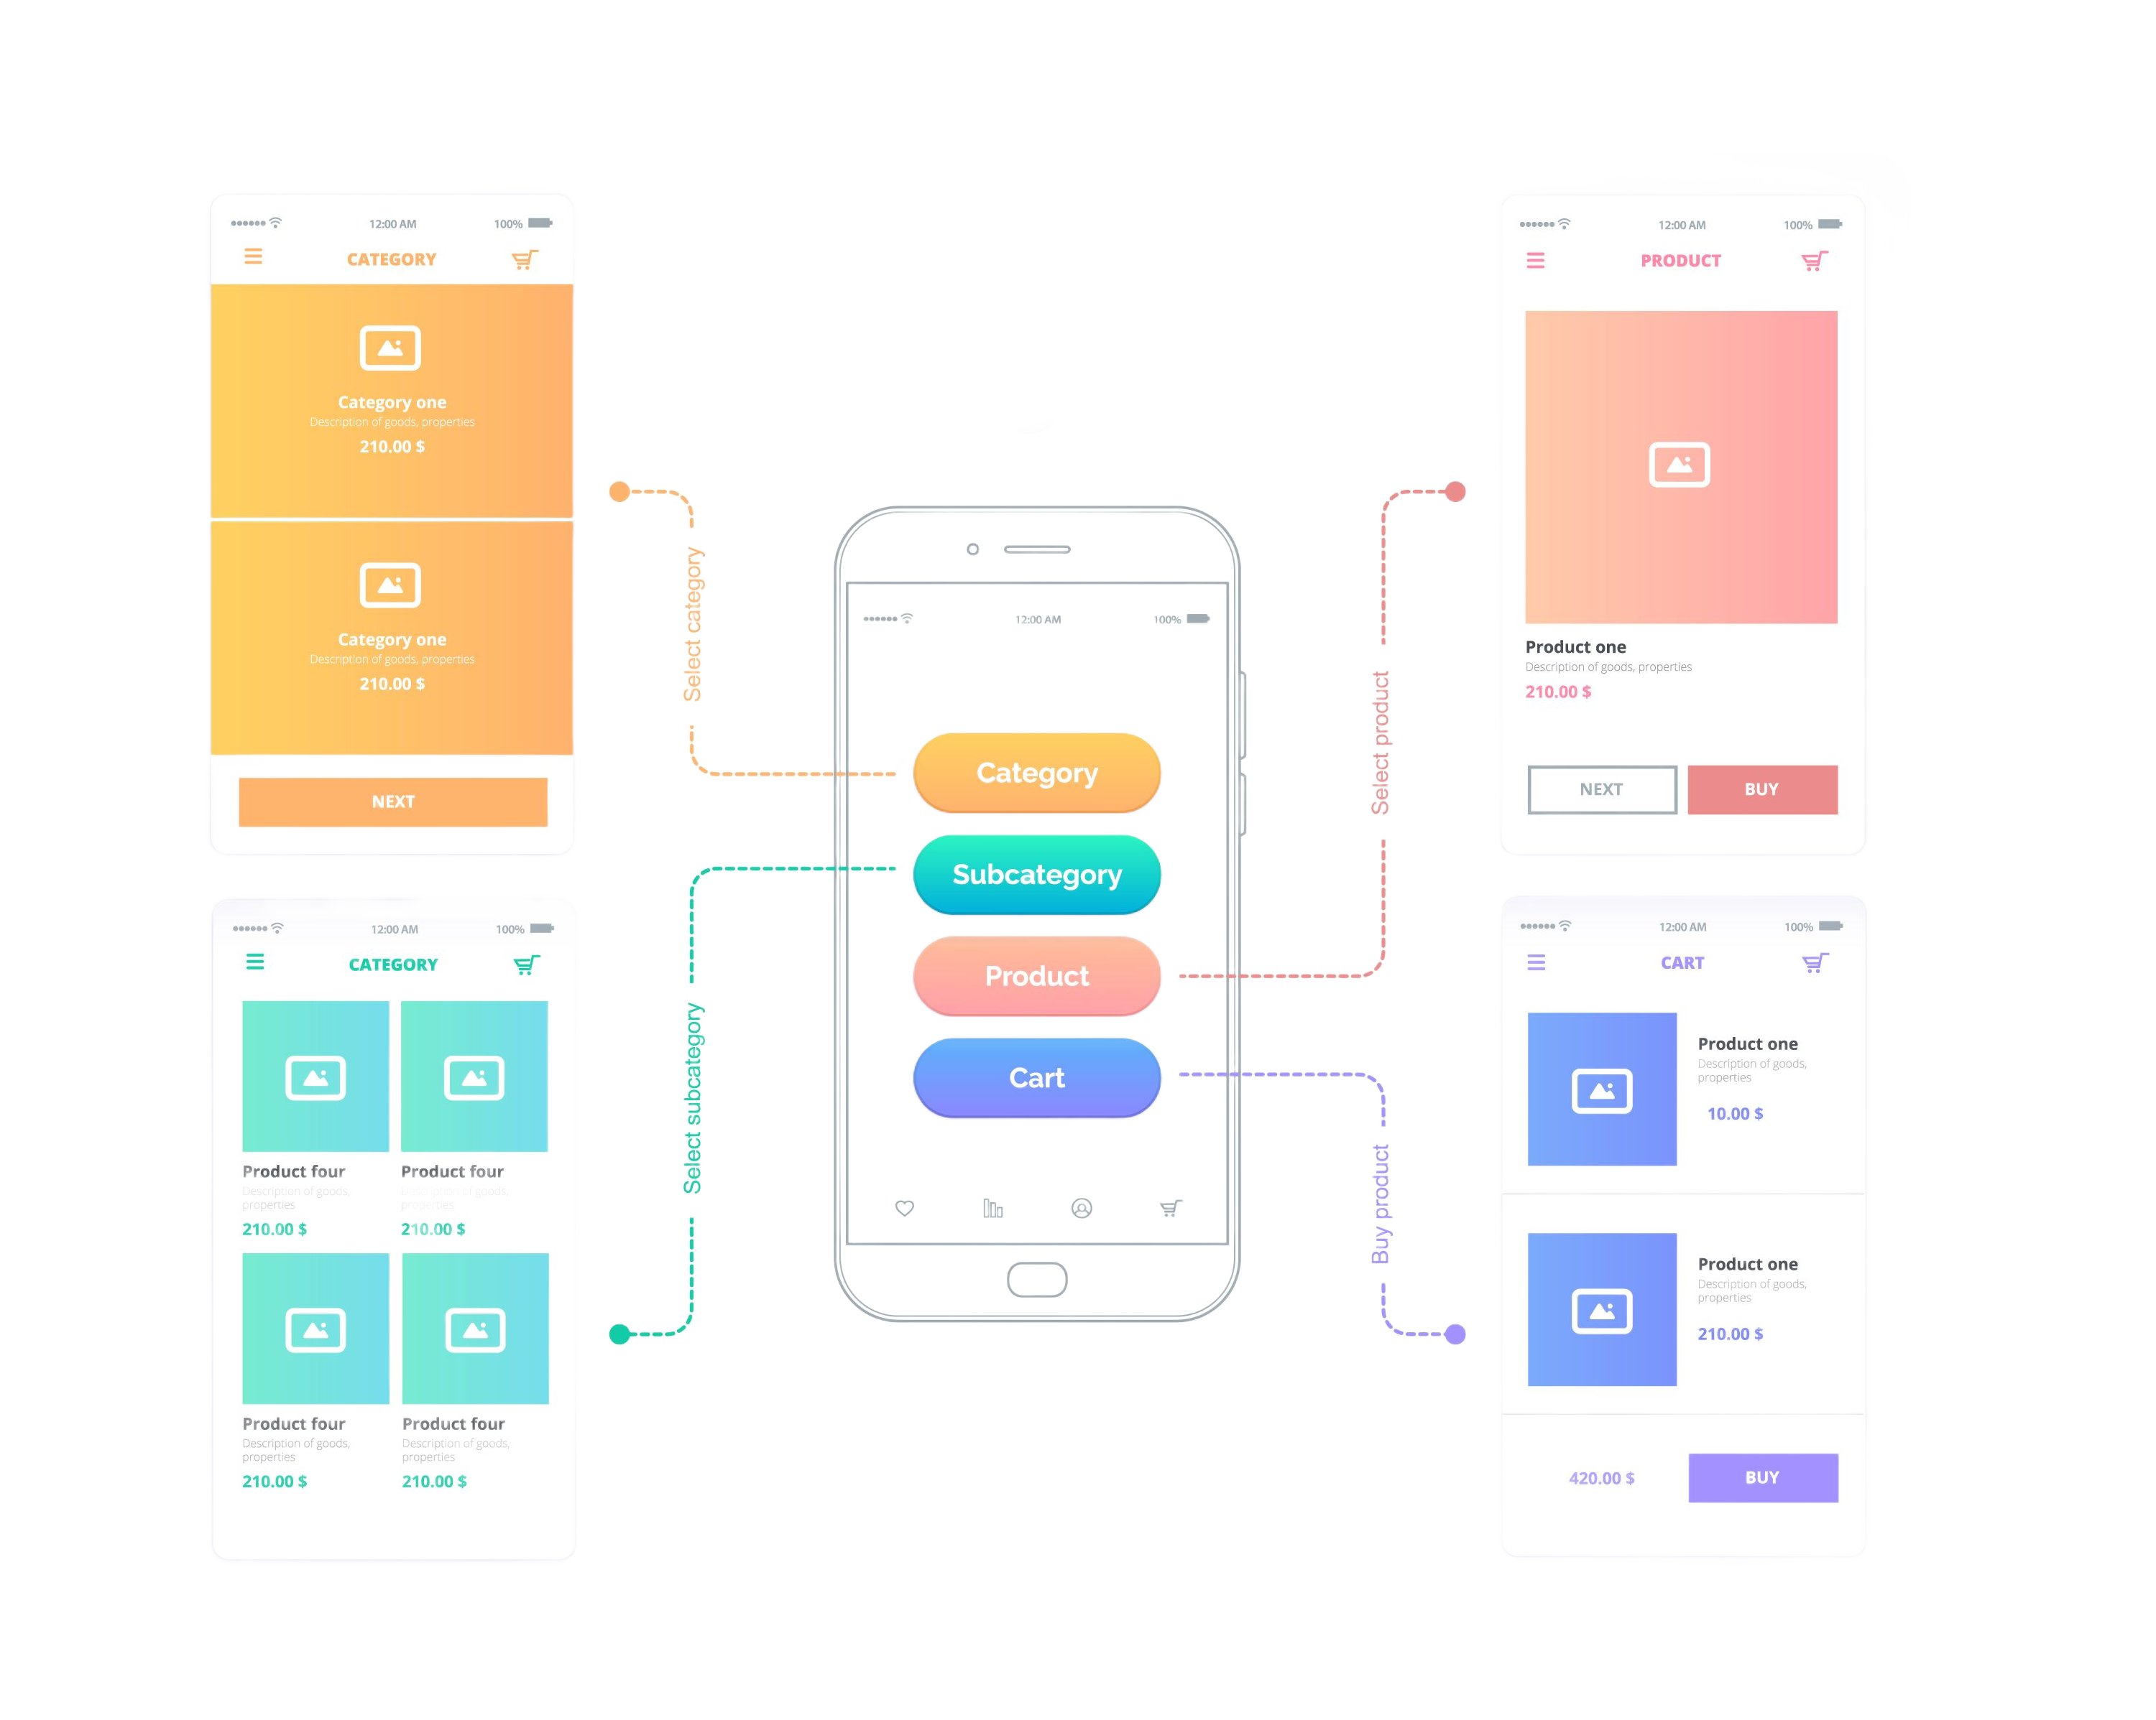
CONTENTS
BUSINESS OVERVIEW
DATA ANALYTICS
ESG & INTEGRATED REPORTING
MARKET
STRATEGY
BUSINESS DEVELOPMENT
BUSINESS TRANSFORMATION
CORPORATE GOVERNANCE
7
MARKET STRATEGY ADVISORY
By harnessing our robust research capabilities and leveraging a global perspective, our interdisciplinary team of professionals collaborates to address your multifaceted business queries. Our bespoke approach encompasses various key areas, offering in-depth solutions in:
Innovation: We assist in enriching your innovation pipeline, identifying groundbreaking opportunities that catalyze continuous growth and keep you ahead in your field.
Market: Our expertise in dissecting current market trends and channel dynamics equips you with the knowledge to respond effectively and stay competitive.
Future: We specialize in decoding the complexities of today’s volatile environment, helping you foresee future trends and sculpt strategies for enduring success.
Brand: Our strategies focus on positioning your brand in a way that resonates deeply with both your customers and your workforce, enhancing brand loyalty and market presence.
Customer: We delve into identifying your target customers, understanding their behaviors, and tailoring strategies to engage them effectively, maximizing brand loyalty and market penetration.
We offer a comprehensive action roadmap tailored to your organization, incorporating insights from global experiences, trend analyses, industry-specific knowledge, and lessons from past crises.
User Experience (UX)
Navigate through complex business challenges with a strategic blend of in-depth research and expert advisory, crafting pathways to enhance growth potential.
Our team specializes in integrating insightful research with practical, strategic consultation, delivering unique and effective growth strategies. Each engagement we initiate is centered around not just planning, but also real-world impact and activation.
Market
Strategy Execution
A strategy is only as good as its execution. AI Konsult provides end-to-end support, from the initial planning phases to the final roll-out. Our strategy execution services ensure that the marketing strategies are implemented effectively, with regular monitoring and adjustments as required.
Marketing Audits
The landscape of marketing is rapidly evolving, and it presents a range of new and complex challenges for Marketing Executives (MEs) across all sectors. They must be adept at making smart and strategic decisions about overall marketing spend, understand and meet the evolving needs and expectations of their customers, and effectively drive conversions to ensure business success.
Competitor & Market Analyses
We conduct thorough competitor and market analyses, using advanced data analytics to provide a comprehensive view of your competitive landscape.
By understanding your competitors' strategies, strengths, weaknesses, and market positions, we craft strategies that not only counteract their moves but also exploit untapped opportunities.
At AI Konsult, we recognize that the user experience (UX) encompasses all interactions and emotions a person encounters before, during, and after using a product, system, or service. We are dedicated to crafting transformative experiences, placing users at the forefront of our design process throughout the entire product lifecycle.
Understanding change is key to creating exceptional experiences.
User behaviors and expectations are evolving. Today, we witness new modes of communication, shifting perceptions of technology, and emerging attitudes towards ethics and trust.
Simultaneously, technology is advancing rapidly, bringing novel experiences through AI and machine learning, 5G networks, voice interactions, mobility solutions, smart cities, and extended reality.
In this landscape of disruptive technologies and fluid user expectations, the way we interact with technology is fundamentally shifting. Users now demand more seamless, secure, and sophisticated experiences.
At AI Konsult, we're committed to staying ahead of these changes, ensuring our designs meet the evolving needs of users in an increasingly connected world.

Slide 10

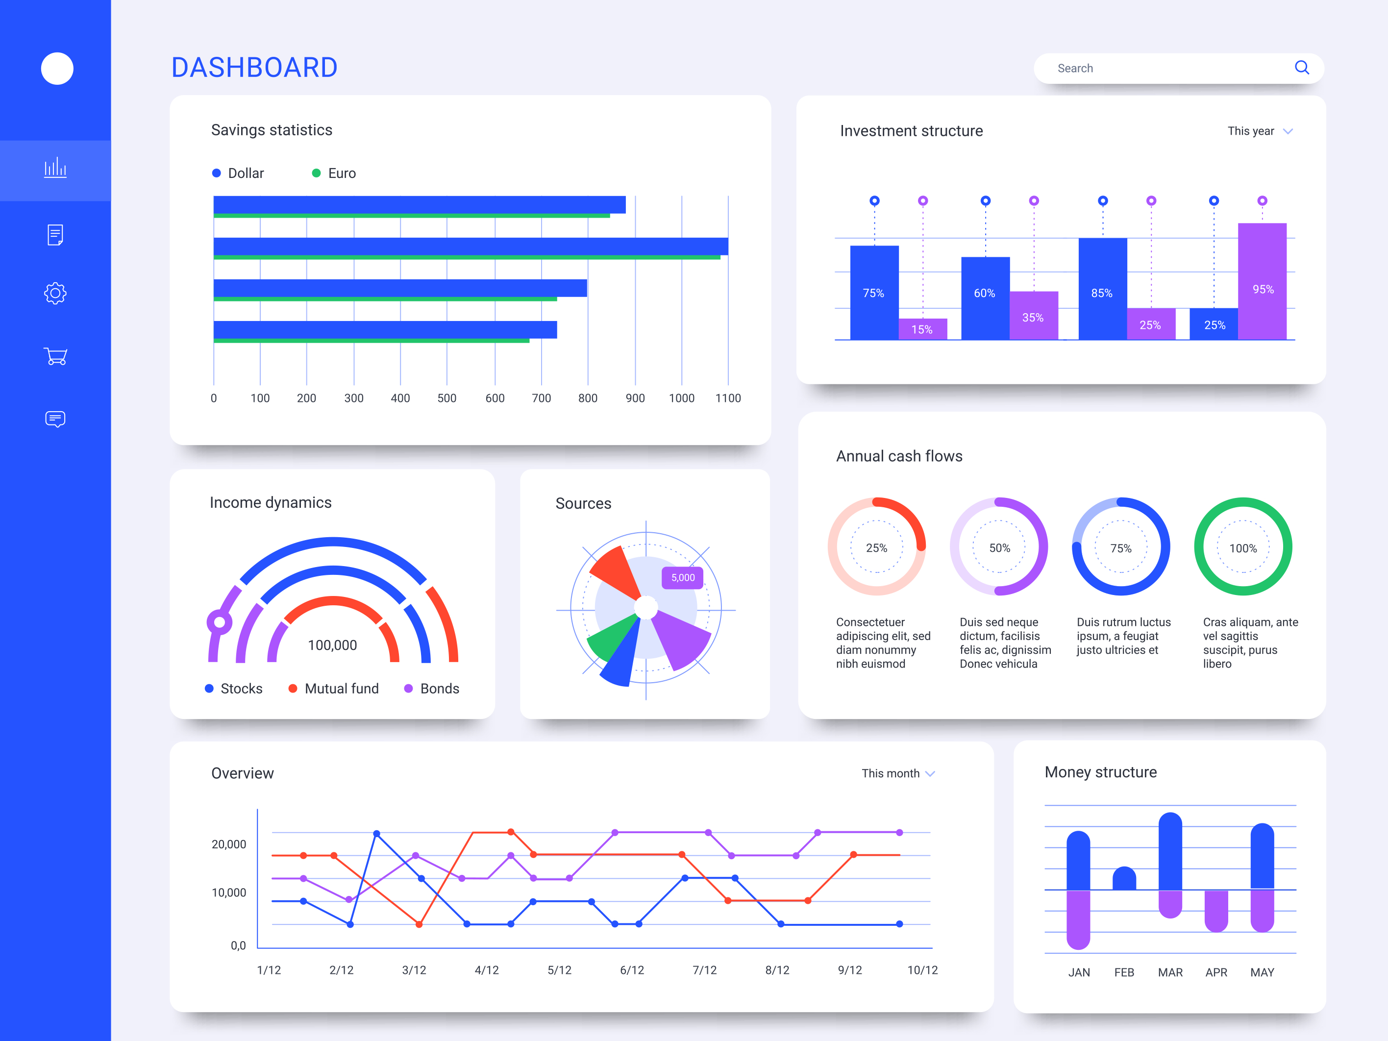
CONTENTS
BUSINESS OVERVIEW
DATA ANALYTICS
ESG & INTEGRATED REPORTING
MARKET
STRATEGY
BUSINESS DEVELOPMENT
BUSINESS TRANSFORMATION
CORPORATE GOVERNANCE
1
BUSINESS DEVELOPMENT
SERVICES
Let Us Create Your Next Business Pitch
AI Konsult excels in empowering businesses with cutting-edge business development services. Our offerings are two-fold, focusing on creating impactful presentations and providing expert coaching.
Creating Smashing Presentations: We understand that in the business world, the first impression is often the last. Our team of skilled designers and content strategists work tirelessly to craft presentations that are not only visually stunning but also effectively communicate your business's core values, goals, and achievements.
Whether it's a pitch to potential investors, a product launch, or a company profile, our presentations are tailored to captivate your audience, leaving a lasting impression.
Visual Storytelling: We believe in the power of storytelling and incorporate this into every presentation, turning data and information into compelling narratives.
Design Excellence: Our design team uses the latest tools and trends to ensure your presentation stands out with a professional and modern aesthetic.
Customized Content: Each presentation is uniquely tailored to reflect your business’s identity, ensuring that your message resonates with your intended audience.
TENDERS
Tenders can indeed be quite stressful. This stress often stems from the competitive nature of the tendering process, the complexity of the requirements, and the high stakes involved:
Tight deadlines
Complex Documentation
Risk of Rejection
Financial implications
Maintaining quality-Ensuring that the proposal is of high quality, error-free, and aligns with the client’s requirements can be demanding.
Winning a tender is not solely about being the most affordable option; it's about presenting a compelling case that highlights your company's competence, the benefits you offer, your ability to adhere to timelines, and your esteemed reputation in the field.
At AI Konsult, we specialize in crafting bespoke tender proposals that encapsulate all these elements.
Business Development Coaching
AI Konsult’s coaching services are designed to hone the skills and strategies necessary for business growth and success. Our coaching team comprises experienced professionals who provide personalized guidance, helping your team develop crucial skills in leadership, communication, strategic planning, and more.
Through expertly crafted presentations and comprehensive coaching, we ensure that you not only capture your audience's attention but also build a strong foundation for sustained business growth and leadership.

Slide 11

CONTENTS
BUSINESS OVERVIEW
DATA ANALYTICS
ESG & INTEGRATED REPORTING
MARKET
STRATEGY
BUSINESS DEVELOPMENT
BUSINESS TRANSFORMATION
CORPORATE GOVERNANCE
7
BUSINESS TRANSFORMATION as a SERVICE (BTaaS)
Business Transformation
Key Indicators that Your Business Needs Transformation
Digital Strategy & Innovation
Service Description: We help you formulate a robust digital strategy, aligning your business goals with the latest technological advancements. Our approach involves a thorough analysis of market trends, competitor strategies, and consumer behaviors to identify opportunities for innovation.
Key Benefits: Stay ahead in your industry with a clear, actionable digital roadmap that drives growth and innovation.
Process Optimization & Automation
Service Description: Our team streamlines your business processes through intelligent automation solutions. Using AI, machine learning, and other advanced technologies, we optimize workflows, enhance efficiency, and reduce operational costs.
Key Benefits: Achieve higher productivity and cost-effectiveness with streamlined, automated processes.
Change Management & Adoption
Service Description: We facilitate smooth transitions for your organization during transformative changes. This includes stakeholder engagement, communication strategies, and training programs to ensure seamless adoption of new processes and technologies.
Key Benefits: Minimize disruption and enhance employee engagement during significant organizational changes.
Customer Experience Transformation
Service Description: We redesign your customer experience strategy to meet evolving expectations. Our approach includes user research, journey mapping, and the integration of advanced technologies to enhance customer interactions.
Key Benefits: Build stronger, lasting relationships with customers through improved experiences.
Declining Sales & Revenue: Consistent decreases in sales and revenue over time indicate a need for transformation. This trend suggests that the business is not effectively meeting market demands or is losing competitive edge.
Low Customer Satisfaction & Retention: If customer satisfaction scores are dropping and there's an increase in customer churn, it's a clear sign that the business needs to reevaluate and improve its products, services, or customer experience.
Outdated Technology & Processes: Reliance on outdated technology and inefficient processes can hinder productivity and innovation. Businesses need to embrace digital transformation to stay relevant and competitive.
High Employee Turnover: A high rate of employee turnover, especially of valuable staff, can indicate issues with company culture, management, or lack of growth opportunities, signaling a need for organizational transformation.
Inability to Adapt to Market Changes: If a business is struggling to adapt to new market trends, regulatory changes, or consumer behaviors, this inflexibility can lead to obsolescence and necessitates a strategic overhaul.
Poor Financial Health: Indicators like dwindling cash flow, high debt, or poor investment returns are critical signs that a business might need to undergo financial restructuring or strategic transformation to improve its financial stability and future prospects.
Business transformation requires an organization to take a critical look at their strategy, operations, spending, and technologies to understand the goal of change.
Do they want to reduce costs, regain their share of the market, or improve customer satisfaction? No matter what the goal of a transformation may be, AI Konsult has identified the three drivers of organizational change
Your data is indicating that there is room for optimization.
Our technology-enabled service teams analyze resource utilization data, mail volume data and more to ensure you are operating in an optimal environment.
You have launched digital transformation efforts & need to align operationally.
With our technologies and enhanced processes implemented, they can focus their time on more important things.
There is room for improvement with your processes.
Processes can make or break the efficiency of a business. Our global experience and tested solutions based in Lean Six Sigma mean we know what it takes to optimize your front and back-end operations.
Sustainable Business Practices
Service Description: Align your business operations with sustainability goals. We help you implement eco-friendly practices and technologies, ensuring your business contributes positively to environmental and social objectives.
Key Benefits: Enhance your brand reputation and meet regulatory requirements with sustainable business practices.
Continuous Learning & Development
Service Description: Empower your workforce with ongoing learning opportunities. We provide tailored training programs and workshops in the latest technologies and business practices.
Key Benefits: Foster a culture of continuous learning to keep your team skilled, motivated, and adaptable.

Slide 12

CONTENTS
BUSINESS OVERVIEW
DATA ANALYTICS
ESG & INTEGRATED REPORTING
MARKET
STRATEGY
BUSINESS DEVELOPMENT
BUSINESS TRANSFORMATION
CORPORATE GOVERNANCE
7
BUSINESS TRANSFORMATION
&
TRANSFORMATIVE AI
AI- In Business Transformation
AI-powered Supply Chain Management: Optimizing Operations
AI’s capabilities are optimizing supply chain operations, with applications in demand forecasting, inventory management, and logistics optimization. Machine learning algorithms analyze historical sales data, market trends, and external factors to enhance demand forecasting accuracy. Real-time insights and advanced analytics provided by AI improve inventory management, and logistics optimization ensures efficient and cost-effective supply chain operations.
AI-enabled Cybersecurity: Fortifying Digital Defenses
As cyber threats become more pervasive and sophisticated, an AI-enabled cybersecurity approach becomes crucial. AI’s learning and adaptive capabilities fortify digital defenses, proactively detecting and preventing cyber threats. This innovative approach provides a strategic advantage in safeguarding sensitive information, countering the evolving tactics of cyber attackers.
Transformative Potential of AI
The array of AI-powered business ideas in 2024 highlights the transformative potential of artificial intelligence. Businesses are tapping into the power of AI to streamline operations, enhance decision-making, and stay competitive in an ever-evolving environment. The ability of AI to automate tasks, analyze datasets, and exceed customer expectations underscores its growing importance globally.
The integration of AI into business processes is shaping industries across the globe. From customer service to healthcare, data analytics, supply chain management, cybersecurity, and personal finance, AI-driven innovations are driving the next wave of business success. The ongoing investment in AI research and development indicates a continued trajectory towards a future where AI is an indispensable tool for businesses seeking a competitive edge.
AI-driven Customer Service: Revolutionizing Support Experiences
In response to rising customer expectations, businesses are turning to AI-powered customer service to revolutionize traditional support models. AI-driven chatbots and virtual assistants provide natural and personalized interactions, offering efficient solutions to customer queries. This innovative approach not only enhances customer experiences but also contributes to operational efficiency.
AI-driven Healthcare:
Revolutionizing Patient Care
The healthcare sector is witnessing a revolutionary transformation with the integration of AI. AI-driven diagnostic tools and predictive analytics platforms are addressing critical challenges, improving diagnostics, expediting drug discovery, and ultimately enhancing patient care. The precision and speed of AI algorithms in analyzing medical images and predicting patient needs mark a significant advancement in the healthcare industry.
AI-powered Data Analytics:
Extracting Valuable Insights
In the age of information, businesses face the challenge of effectively leveraging vast datasets. AI-powered data analytics emerges as a transformative solution, offering unprecedented processing power to analyze large datasets rapidly. These AI algorithms excel in identifying intricate patterns within data, enabling businesses to tailor products, marketing strategies, and optimize operational processes based on valuable insights.
The integration of artificial intelligence (AI) into business processes is proving to be a game-changer, offering a significant boost to competitiveness. As AI algorithms advance, businesses can automate tasks, analyze extensive datasets, and gain valuable insights for informed decision-making.
This transformative technology allows for streamlined operations, increased productivity, and a competitive edge in today’s fast-paced business landscape.
Global Acceptance & Investment in AI
AI’s potential is now widely recognized across industries, from healthcare and finance to supply chain management and cybersecurity. Governments and organizations worldwide are investing heavily in AI research and development, fostering an environment conducive to the flourishing of AI-driven business ideas. The continuous advancements in technology and the global acceptance of AI are propelling businesses toward a new era of success and growth.

Slide 13
CONTENTS
BUSINESS OVERVIEW
DATA ANALYTICS
ESG & INTEGRATED REPORTING
MARKET
STRATEGY
BUSINESS DEVELOPMENT
BUSINESS TRANSFORMATION
CORPORATE GOVERNANCE
7
WHY WORK WITH AI KONSULT?
Transformation
Analytics
Business Intelligence
Reporting
Innovative Solutions: AI Konsult provides cutting-edge AI-driven solutions that can radically transform business processes, making them more efficient and effective.
Customization: Offers tailored AI solutions that align with specific business needs, ensuring a personalized and effective transformation.
Competitive Edge: Utilizes advanced AI technologies to give businesses a competitive advantage through innovative approaches and operational efficiency.
Cost Efficiency: AI-driven automation and optimization reduce operational costs, contributing to a healthier bottom line.
Scalability: Solutions are scalable, supporting businesses as they grow and adapt to market changes.
Change Management Support: AI Konsult aids in managing the transition, ensuring smooth implementation and adoption of new technologies and processes.
Advanced Data Analysis: Employs sophisticated AI algorithms for deep data analysis, uncovering valuable insights.
Predictive Analytics: Offers predictive analytics capabilities, enabling businesses to anticipate market trends and customer behavior.
Real-Time Insights: Provides real-time analytics, allowing for quick and informed decision-making.
Data-Driven Decisions: Facilitates data-driven decision-making, enhancing accuracy and efficiency.
Custom Analytical Tools: Develops custom tools that fit unique business needs for analytics.
Comprehensive Reporting: Delivers comprehensive and understandable reports from complex data sets.
Enhanced Decision Making: Integrates AI with BI to provide deeper insights, supporting enhanced decision-making.
Market Trends Analysis: Utilizes AI to analyze market trends, helping businesses stay ahead of the curve.
Operational Efficiency: Improves operational efficiency through AI-driven process optimization.
Customer Insights: Provides detailed customer insights for better market positioning and strategy.
Risk Management: Employs AI for effective risk assessment and management.
Integration of Diverse Data Sources: Seamlessly integrates data from various sources for a holistic view of business performance.
Automated Reporting: Automates reporting processes, saving time and reducing errors.
Customizable Dashboards: Offers customizable dashboards for a clear view of key performance indicators and metrics.
Interactive Reports: Creates interactive reports for a more engaging analysis.
Data Visualization: Utilizes advanced data visualization techniques for better understanding of complex data.
Timely Delivery: Ensures timely delivery of reports for prompt decision-making.
Compliance & Accuracy: Maintains high standards of compliance and accuracy in reporting.
In today’s rapidly evolving business landscape, staying ahead of the curve is not just an ambition, it's a necessity. This is where AI Konsult steps in - your ideal partner for transforming your business into a future-ready, data-driven powerhouse. With AI Konsult, you’re not just adapting to change; you’re driving it.
Our expertise in AI-driven transformation, analytics, business intelligence, reporting, strategic planning, and corporate governance, including ESG, positions us uniquely to elevate your business to new heights of efficiency and competitiveness.
Embrace the future with AI Konsult – where innovation meets excellence, driving your business towards unparalleled success. Let's redefine what's possible together!

Slide 14


Disclaimer & Legal Notice
General
Please note that the information provided in this document by Artificial Intelligence (Pty) Ltd / AI Konsult, including its partners and associates, is for general informational purposes only. All efforts have been made to ensure the information is current and accurate; however, AI Konsult does not guarantee the completeness, accuracy, or reliability of this information. The content provided should not be solely relied upon for making decisions without consulting primary or more accurate, more complete, or more timely sources of information.
Confidentiality
Any information contained within this document is confidential and intended solely for the use of the individual or entity to whom it is addressed. Unauthorized use, disclosure, or copying of this document or any part thereof is strictly prohibited and may be unlawful. If you have received this document in error, please notify AI Konsult immediately.
Intellectual Property Rights
This document, including all content and graphics, is the intellectual property of Artificial Intelligence (Pty) Ltd / AI Konsult, protected under the laws of Botswana. Unauthorized reproduction, distribution, or modification of this document, in whole or in part, without the prior written consent of AI Konsult is prohibited and may constitute a violation of intellectual property laws.
Limitation of Liability
In no event will AI Konsult, its partners, or associates be liable for any loss or damage including without limitation, indirect or consequential loss or damage, arising from the use of or reliance on the information provided in this document.
Governing Law
This disclaimer and legal notice shall be governed by and construed in accordance with the laws of Botswana. Any disputes arising out of or in relation to this notice shall be subject to the exclusive jurisdiction of the courts of Botswana.
Changes
This notice is subject to changes and updates at the discretion of AI Konsult without prior notice. Your use of this document signifies your acceptance of this disclaimer and legal notice.
Privacy
Client Privacy Protection
AI Konsult undertakes an unwavering commitment to maintain the highest level of confidentiality with respect to the information and proprietary data of our esteemed clients.
We pledge to rigorously safeguard and protect sensitive business information from any unauthorized access, usage, or dissemination.
Non-Disclosure of Client Identities
We assure our clients that AI Konsult shall never advertise, disclose, or reveal the identities of the clients we have served or currently work with.
This practice ensures that our clients' strategic initiatives, competitive edge, and market positioning remain strictly confidential.
Core Values and Ethical Foundation
Integrity, Security, and Trust
Our operational ethos is firmly entrenched in the principles of integrity, security, and trust.
AI Konsult is resolutely committed to adhering to the highest standards of ethical conduct, promoting transparency, and fostering a culture of trust among our clients, partners, and stakeholders.
Client-Centric Engagement Approach
Singular Client Focus: In our pursuit of delivering exceptional value, AI Konsult maintains an exclusive focus on serving one client at a time. This distinctive approach empowers us to marshal our collective expertise, knowledge, and resources towards devising bespoke strategies tailored to our client's unique objectives.
Advisory Vigilance and Ethical Prudence
Comprehensive Brief and Ethical Parameters: We uphold a stringent criterion for engagement, ensuring that project timelines and briefs align with our commitment to providing actionable insights while adhering to ethical standards and quality.
We reserve the right to decline opportunities that lack comprehensive information or deviate from ethical norms, prioritizing the well-being of our clients and the responsible utilization of information.
Stakeholder Welfare and Legal Compliance
Social Responsibility: AI Konsult remains unwavering in its dedication to societal welfare.
We pledge to refrain from engaging with entities or individuals that have been legally proven to commit serious infractions against our values.
Our commitment extends towards safeguarding the world; environment, humanity, animals, and marginalized communities.
BUSINESS
ADVISORY SERVICES PROFILE
AI KONSULT
Contact Person : Scelo Hlope I Business Lead
Contact Number : (+267) 71-333-551
E-mail: scelo@ai.co.bw
Address: Plot 7372 , Unit 2B , 23 Square 30 Phakalane | Gaborone | Botswana
A DIVISION OF ARTIFICIAL INTELLIGENCE (Pty) Ltd
BW00002314974

Slide 15

Brilliance
Health Data Analytics & Informatics
Mirroring a diamond's brilliance, our approach to Health Data Analytics & Informatics radiates with the power to illuminate hidden insights. We harness vast healthcare data, applying advanced analytics to bring clarity to complex health scenarios, ensuring every decision made is informed and precise.
Color
Electronic Data Interchange (EDI)
The color of a diamond can range from colorless to vibrant hues, much like the spectrum of information in healthcare. Our Electronic Data Interchange (EDI) facet ensures the seamless and vibrant flow of healthcare data. We enable a spectrum of healthcare communications, from patient records to billing, maintaining vibrancy and diversity in information exchange.
DIAMOND HEALTH MODEL
Clarity
Telehealth
In the clarity of a diamond, one finds purity and transparency. Our Telehealth services offer a clear, unobstructed view into healthcare accessibility. We bridge distances, bringing the lucidity of expert care to patients regardless of geographical barriers, ensuring clarity in healthcare delivery.
Cut
Digital Health Strategy
The cut of a diamond determines its symmetry and balance. Our Digital Health Strategy facet reflects this property through meticulous planning and implementation of digital tools. We sculpt our healthcare services to perfection, ensuring every strategic angle is optimized for peak performance and alignment with overarching healthcare goals.
Carat
Health & Wellness App Development
Like the weight of a diamond measured in carats, our Health & Wellness App Development represents the substantial impact of mobile health technology. We develop robust applications that carry significant value in managing and promoting health and wellness, adding weight to the preventive aspect of healthcare.
Craftsmanship
Advisory & Consulting Services
The final crafting of a diamond is pivotal to its overall allure. In a similar vein, our Advisory Services are the craftsmanship behind our model. We provide expert consultation and guidance, ensuring that healthcare practices are not only current but also visionary, mirroring the foresight and precision seen of a master jeweler.

Slide 16

DIAMOND HEALTH MODEL

